Slide 1
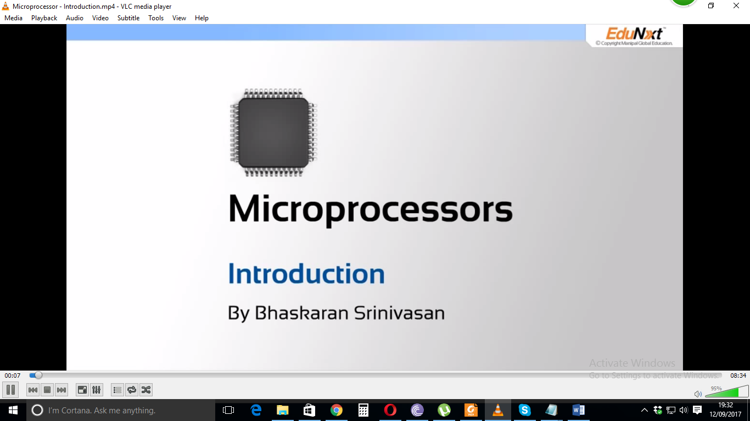

Slide 2
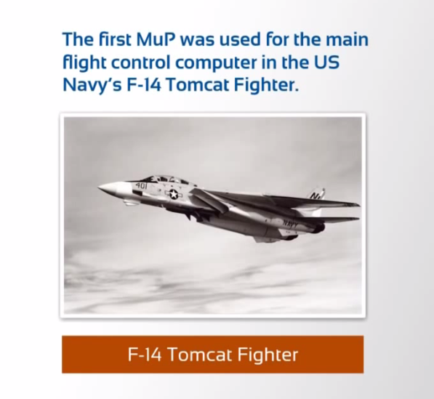
Microprocessors

Slide 3
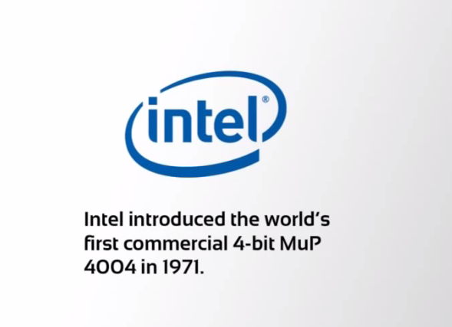
Intel Microprocessor

Slide 4
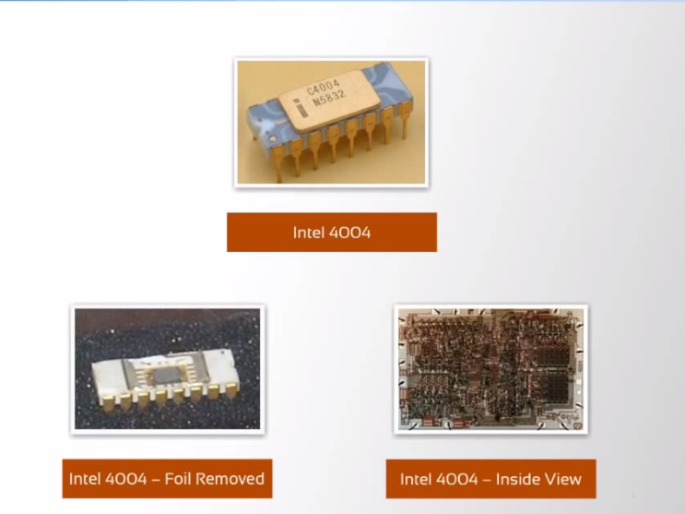
Intel 4004 Microprocessor

Slide 5
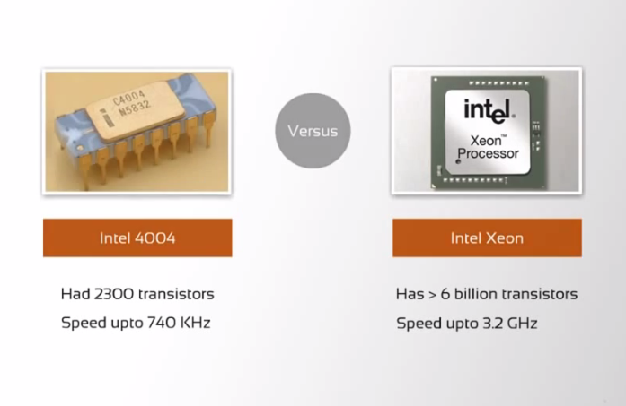
Microprocessors

Slide 6
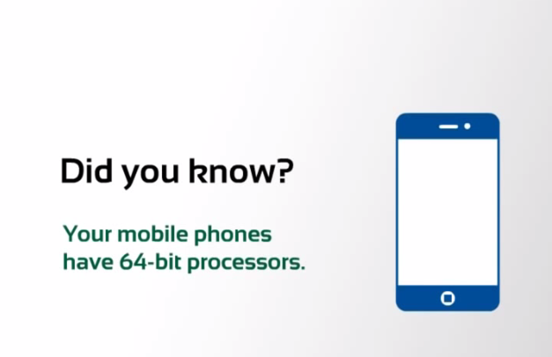
Microprocessors

Slide 7
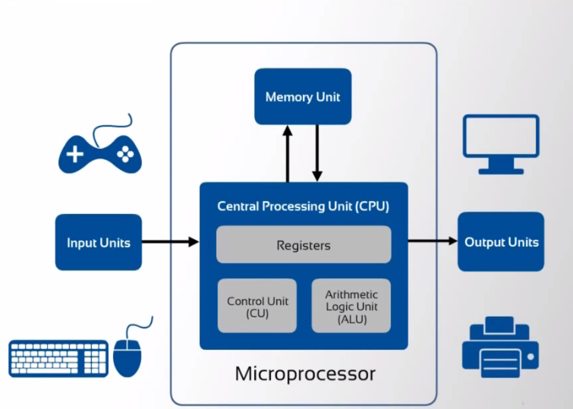
Component of a Computing System

Slide 8
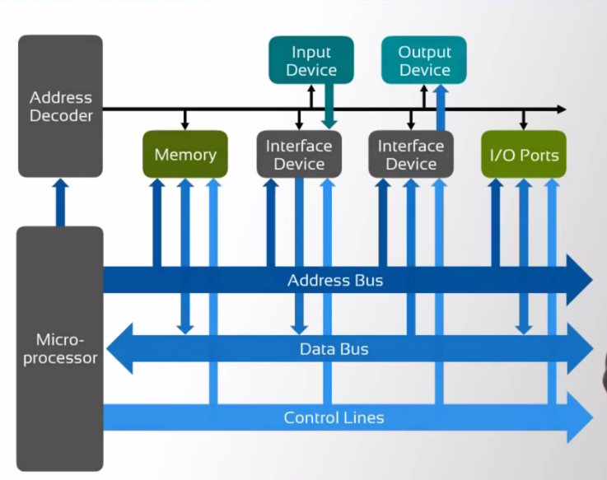
How does the Microprocessor Connect to the external world?

Slide 9
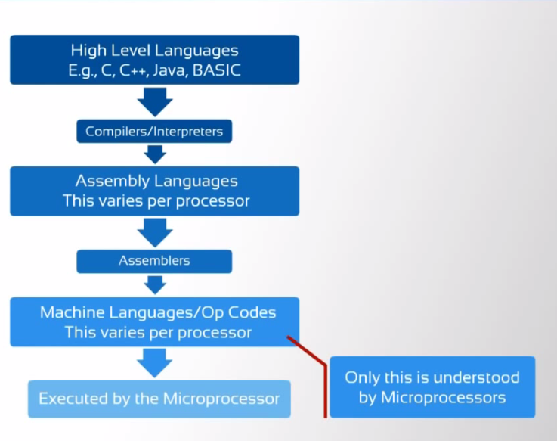
What are the kinds of languages that a Microprocessor Understands?

Slide 10
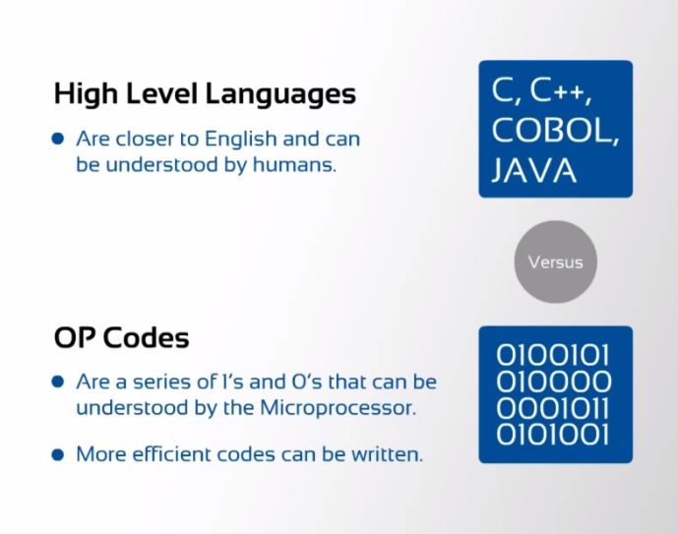
What are the kinds of languages that a Microprocessor Understands?

